Slide 1

Department of Computer Science & Engineering BRAC University.
Interrupts
Course ID: CSE341
Course Title: Microprocessors

Slide 2
Lecture References:
Book:
Microprocessors and Interfacing: Programming and Hardware, Author: Douglas V. Hall
Microprocessor and Microcomputer – Based System Design, Author: Mohamed Rafiquzzaman
CSE – 341 : Microprocessors
BRAC University

Slide 3
Interrupt
Interrupt is a process where a normal program execution to be interrupted by some external signal or by a special instruction in the program.
Microprocessor pay attention to the interrupt stopping the current execution.
What happens when MP is interrupted ?
When the Microprocessor receives an interrupt signal, it suspends the currently executing program and jumps to an Interrupt Service Routine (ISR) to respond to the incoming interrupt.
Each interrupt will have its own ISR.
After finishing the second program/interrupt, automatically return to the first program and start execution from where it was left
CSE – 341 : Microprocessors
BRAC University

Slide 4
Interrupt
The processor can be interrupted in the following ways:
i ) by an external signal generated by a peripheral, such as Keyboard, Mouse, Printer, etc.
ii) by an internal signal generated by a special instruction in the program,
iii) by an internal signal generated due to an exceptional condition which occurs while executing an instruction.
CSE – 341 : Microprocessors
BRAC University

Slide 5
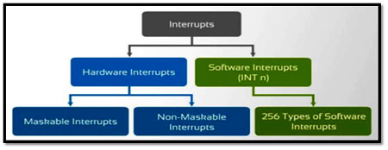
Classification of Interrupts
CSE – 341 : Microprocessors
BRAC University

Slide 6
Hardware Interrupt
Hardware Interrupts:
The interrupts initiated by external hardware by sending an appropriate signal to the interrupt pin of the processor is called hardware interrupt.
The 8086 processor has two interrupt pins INTR (18) and NMI (17).
The interrupts initiated by applying appropriate signal to these pins are called hardware interrupts of 8086.
Hardware Interrupts Used to handle external hardware peripherals such as key boards , mouse , hard disks , floppy disks , DVD drivers, printers, mouse, DVD drivers, floppy disks, key boards etc.
CSE – 341 : Microprocessors
BRAC University

Slide 7
Maskable and Non-Maskable
The processor has the facility for accepting or rejecting hardware interrupts.
Maskable Interrupts (Can be delayed or Rejected) The interrupts whose request can be either accepted or rejected or delayed by the processor are called maskable interrupts.
Example: User-defined interrupts. In 8086 processor all the hardware interrupts initiated through INTR pin are maskable by clearing interrupt flag (IF).
Non-Maskable Interrupts (Can not be delayed or Rejected) The interrupts whose request has to be definitely accepted (or cannot be rejected) by the processor are called non-maskable interrupts.
Example: The interrupt initiated through NMI pin and all software interrupts are non-maskable.
CSE – 341 : Microprocessors
BRAC University

Slide 8
Examples
Non-Maskable Interrupts
Used during power failure
Used during critical response time
Used during non-recoverable hardware errors
Used during memory parity errors
Maskable Interrupts
Interrupt from mouse, keyboard or other peripherals
CSE – 341 : Microprocessors
BRAC University

Slide 9
Software Interrupts
The software interrupts are program instructions.
These instructions are inserted at desired locations in a program.
While running a program, if software interrupt instruction is encountered then the processor initiates an interrupt.
The 8086 processor has 256 types (00 to FF) or (00 to 255) of software interrupts. The software interrupt instruction is INT n, where n is the type number in the range 0 to 255.
CSE – 341 : Microprocessors
BRAC University

Slide 10
Classifications of 8086 Interrupts
An 8086 interrupt can come from any of the three sources:
An external signal applied to NMI or INTR pin.
known as hardware interruption
It is a user-defined interrupt
Execution of interrupt instruction INT.
referred as software interruption
It is also a user-defined interrupt
Some error condition produced by execution of an instruction, e.g., trying to divide some number by zero.
It is known as pre-defined interrupt
CSE – 341 : Microprocessors
BRAC University

Slide 11
Interrupt Vectors and Vector Table
All interrupts (vectored or otherwise) are mapped onto a memory area called the Interrupt Vector Table (IVT).
The IVT is usually located in the first 1 Kbyte of memory segment (from 00000 H - 003FF H).
The purpose of the IVT is to hold the vectors that redirect the microprocessor to the right place when an interrupt arrives.
An interrupt vector is a pointer to where the ISR is stored in memory.
The starting address of an ISR is often called
the interrupt vector or the interrupt pointer.
So the Table is referred to as
interrupt-vector table or interrupt-pointer table.
CSE – 341 : Microprocessors
BRAC University

Slide 12
Interrupt Types based on ISR ID
AVAILABLE |  | 003FFH |  | TYPE 255
FOR USER |  |  |  | ...
(224) |  | 00080H |  | TYPE 32
 |  |  |  | TYPE 31
RESERVED (27) |  |  |  | ...
 |  | 00014H |  | TYPE 5
 |  |  |  | TYPE 4
 |  | 00010H |  | INTO OVERFLOW
 |  |  |  | TYPE 3
Predefined/ |  | 0000CH |  | INT
Dedicated/Internal |  |  |  | TYPE 2
Interrupts Pointers |  | 00008H |  | NON-MASKABLE
(5) |  |  |  | TYPE 1
 |  | 00004H |  | SINGLE STEP
CS Base Address |  |  |  | TYPE 0
IP Offset |  | 00000H |  | DIVIDE ERROR
CSE – 341 : Microprocessors
BRAC University

Slide 13
Interrupt Types based on ISR ID
Note that
The IP value is put in as the low word of the vector
CS as high word of the vector
4 bytes are required to store the CS and IP values for each interrupt service procedure, the interrupt-vector table can hold starting addresses for up to 256 interrupt procedures.
Each Double Word interrupt vector is identified by a number from 0 to 255
INTEL calls this number the TYPE of the interrupt
CS = 2 bytes, IP = 2 Bytes, so total 4 bytes are needed for Interrupt and there are total 256 interrupts, where 256 x 4 = 1024 Bytes = 1 KB are located in the starting part of memory
CS:IP = 0000:0000 to 0000:03FF
CSE – 341 : Microprocessors
BRAC University

Slide 14
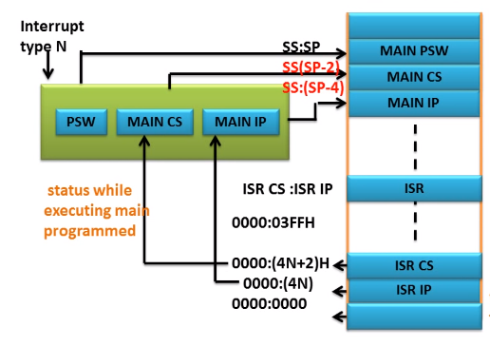
How Interrupt is serviced
CSE – 341 : Microprocessors
BRAC University

Slide 15
Function of 8086 during Interrupts
At the end of each instruction cycle, 8086 checks to see if any interrupts have been requested.
If yes, then 8086 responds to the interrupt by stepping through the following series of major actions:
It decremented SP by 2 and pushes Flag register on the stack.
It disables 8086 INTR input by clearing IF (Interrupt) flag in Flag register
It resets the TF (Trap) flag in Flag register
It decremented SP again by 2 and pushes current CS (Code Segment) contents on the stack.
It decremented SP again by 2 and pushes current IP (Instruction Pointer) contents on the stack.
It does an indirect far Jump to the start of the procedure written to respond to the interrupt.
CSE – 341 : Microprocessors
BRAC University

Slide 16
Function of 8086 during Interrupts
1. Push FLAGS
2. Clear IF
3. Clear TF
4. Push CS
5. Push IP
6. Fetch ISR
address
Interrupt Service Routine (ISR)
main
Program
PUSH registers
...
...
...
....
...
POP registers
IRET
POP IP
POP CS
POP FLAGS
CSE – 341 : Microprocessors
BRAC University

Slide 17
Calculation
Now we know that the interrupt number (nn) is 60. So we can easily get the effective address from the interrupt vector table. For any interrupt number there are 4 line address first two for IP and last two for CS.
The equation to get effective address from IP:CS is,
IP = (nn x 4) and CS = (nn x 4) + 2
So for 60, the RAM location of IP is (60 x 4 ) = 240 or 000F0h & 241 or 000F1h. And the RAM location of CS are 242 or 000F2h & 243 or 000F3h. The value of IP & CS are 012h & 0E8h respectively.
Now from CS:IP we get the physical address where the interrupt service routine exist. Here the 20 bit physical address is 0E92h. Through this address we get the ISR and it will execute until the IRET which declare the last instruction of ISR.
CSE – 341 : Microprocessors
BRAC University

Slide 18
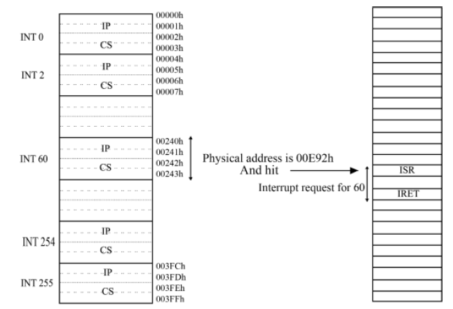
Calculation
00E80
00012
00E92
012h
0E8h
CSE – 341 : Microprocessors
BRAC University

Slide 19
Why Interrupt is Necessary?
First Type: POLLED I/O or PROGRAMMED I/O communication between MP and I/O devices.
BUS
µP
I/O
device n
I/O
device1
...
You?
You?
You?
Disadvantages of Second Type Communication:
not fast enough
waste too much microprocessor time
CSE – 341 : Microprocessors
BRAC University

Slide 20
Why Interrupt is Necessary?
Third Type: INTERRUPTED I/O communication between MP and I/O devices.
BUS
µP
INT
INT
I/O
device1
...
I/O
device n
INT
INT
INT
Interrupts are particularly useful when I/O devices are slow
CSE – 341 : Microprocessors
BRAC University

Slide 21
Polling and Interrupt
Both are methods to notify processor that I/O device needs attention
Polling
simple, but slow
processor check status of I/O device regularly to see if it needs attention
similar to checking a telephone without bells!
Handled by CPU
Interrupt
fast, but more complicated
processor is notified by I/O device (interrupted) when device needs attention
Handled by Interrupt - handler
similar to a telephone with bells
CSE – 341 : Microprocessors
BRAC University

Slide 22
Interrupt Types based on ISR ID
AVAILABLE |  | 003FFH |  | TYPE 255
FOR USER |  |  |  | ...
(224) |  | 00080H |  | TYPE 32
 |  |  |  | TYPE 31
RESERVED (27) |  |  |  | ...
 |  | 00014H |  | TYPE 5
 |  |  |  | TYPE 4
 |  | 00010H |  | INTO OVERFLOW
 |  |  |  | TYPE 3
Predefined/ |  | 0000CH |  | INT
Dedicated/Internal |  |  |  | TYPE 2
Interrupts Pointers |  | 00008H |  | NON-MASKABLE
(5) |  |  |  | TYPE 1
 |  | 00004H |  | SINGLE STEP
CS Base Address |  |  |  | TYPE 0
IP Offset |  | 00000H |  | DIVIDE ERROR
CSE – 341 : Microprocessors
BRAC University

Slide 23
Divide by zero interrupt- Type 0
It occurs automatically when the result of DIV or IDIV is too large
Example:
DIV BL //This will do AX÷BL
//will put result in AL(quotient) and AH(reminder)
If AX was 4000H and BL was 02H,
The quotient is 2000H and reminder is 00H.
µP can put 00H in AH(reminder)
But it cannot put 2000H in AL(quotient)
This condition is called divide error!
Again by mistake, we do a division operation where divisor is 0, such as AX = 4000H and BL = 00H, then the result will be infinity and it is the largest number that can not be stored in AL or AX whatever.
This is also divide by 0 error or Type 0 interrupt.

Slide 24
Single Step Interrupt- Type 1
In single step mode, a system will stop after it executes each instructions and wait for further direction
If the 8086 trap flag is set, the 8086 will automatically do a type 1 interrupt after each instruction executes
The trap flag is reset when the 8086 does a type 1 interrupt, so the single step mode will be disabled during the interrupt-service procedure
Tasks for implementing single stepping:
Set the trap flag
Write an interrupt service procedure which saves all registers on the stack
The stack where they can later be examined
Load the starting address of the type 1 interrupt service procedure into address 00004H and 00006H

Slide 25
Non-Maskable Interrupt- Type 2
The 8086 will automatically do a type 2 interrupt response when it receives a low to high transition on its NMI input pin
The 8086 gets the CS value for the start of the type 2 interrupt service procedure from address 0000AH and the IP value for the start of the procedure from address 00008H
The type 2 interrupt response cannot be disabled by any program instruction that’s why we use it to signal the 8086 that some condition in an external system must be taken care of
The type 2 interrupt is useful to save program data in case of a system power failure

Slide 26
Breakpoint Interrupt- Type 3
The main use of type 3 interrupt is to implement a breakpoint function in a system
Unlike the single step feature, which stops execution after each instruction, the breakpoint feature executes all the instruction up to the inserted breakpoint and then stops execution
The 8086 gets the CS value for the start of the type 3 interrupt service procedure from address 0000EH and the IP value for the start of the procedure from address 0000CH
It is useful in debugging large programs when single stepping is inefficient

Slide 27
Overflow Interrupt- Type 4
The 8086 overflow flag (OF) will be set if the signed result of an arithmetic operation on two signed numbers is too large to be represented or memory location
The 8086 will get the CS value for the start of the type 4 interrupt service procedure from address 00012H and the IP value for the start of the procedure from address 00010H
It is useful to detect overflow error in signed arithmetic operations
There are two ways to detect and respond to an overflow error in a program
Put the jump if overflow instruction (JO) immediately after the arithmetic instruction
Put the interrupt on overflow instruction (INTO) immediately after the arithmetic instruction

Slide 28
Summary of 8086 Interrupt Function …
What happens if two or more interrupts occur at the same time?
Higher priority interrupts will be served first
Interrupt Type | Priority
DIVIDE ERROR, INTn, INT0 NMI INTR SINGLE STEP | HIGHEST LOWEST
CSE – 341 : Microprocessors
BRAC University

Slide 29
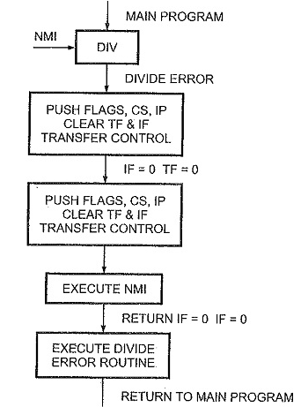
Flow Chart for Divide Error Routine
CSE – 341 : Microprocessors
BRAC University

Slide 30
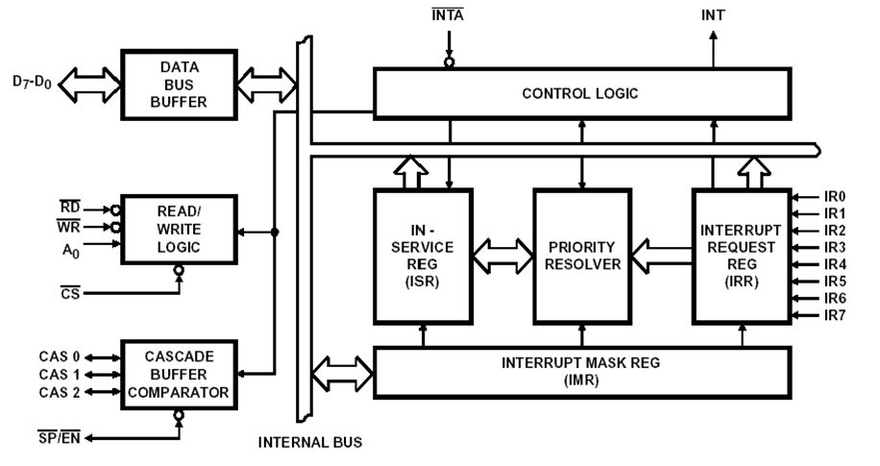
8259A Programmable Interrupt Controller (PIC)

Slide 31
How 8086 INTR input works
If the 8086 Interrupt flag is set and the INTR input receives a high signal, the 8086 will:
Send out two interrupt acknowledgement pulses on its INTA pin to the INTA pin of 8259 PIC. The INTA pulses tell the 8259A to send the desired interrupt type to the 8086 on the data bus.
Multiply the interrupt type it receives from the 8259A by 4 to produce an address in the Interrupt Vector Table. INT60 means 60 X 4 = 240h
Push the flags on the stack
Clear IF and TF
Push the return address on the stack.
Get the starting address for the interrupt procedure from the IVT and load thar address in CS and IP.
Execute the interrupt service procedure.

Slide 32
8259A Internal Block Diagram

Slide 33
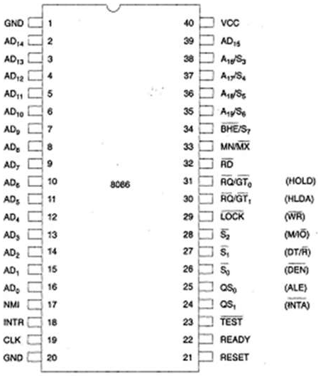
Connection with 8086
8086
8259

Slide 34
Registers
IRR:
ISR:
IMR:
0 | 0 | 0 | 0 | 0 | 0 | 0 | 0
IR7
IR6
IR5
IR4
IR3
IR2
IR1
IR0
0 | 0 | 0 | 0 | 0 | 0 | 0 | 0
ISR7
ISR6
ISR5
ISR4
ISR3
ISR2
ISR1
ISR0
0 | 0 | 0 | 0 | 0 | 0 | 0 | 0
IR7
IR6
IR5
IR4
IR3
IR2
IR1
IR0

Slide 35
The 8259A System Connections
The 8259A is used to increase the number of interrupts
The 8 bit data bus allows 8086 to send control words to the 8259A and read a status word from the 8259A and also allows to send interrupt types to the 8086
The RD’ and WR’ inputs control the transfer
When an interrupt occurs corresponding bit becomes 1 in (IR0-IR7), it checks IRR to know which interrupt has occurred, it checks IMR to know which interrupts are masked and it checks ISR to know which interrupts are in service
If the interrupt occurs is in higher priority, not masked and its in higher priority than the interrupt which was in service then its validate and it will be send to the µp on INTR

Slide 36
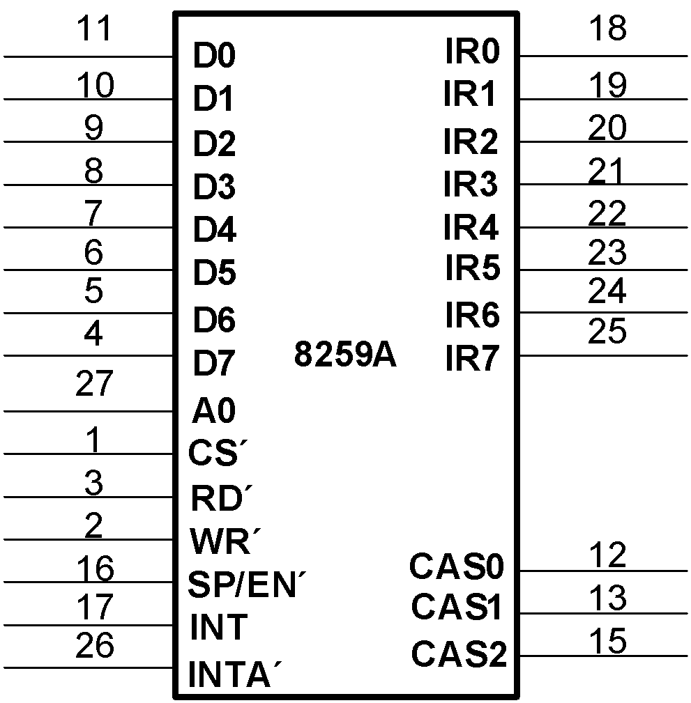
The 8259A Priority Interrupt Controller
Adds 8 vectored priority encoded interrupts to the microprocessor
Can be expanded without additional hardware to accept up to 64 IRQ (master and slave PIC’s)
D0-D7: Bidirectional data connections
IR0-IR7: Interrupt request inputs
WR΄: Write input strobe
RD΄: Read input connects to the IORC
INT: Output, connects to μP INTR pin
INTA΄: Input, connects to μP INTA΄ pin
A0: Command word select
CS΄: Chip select input
SP/EN΄: Slave program/enable buffer pin
CAS0-CAS2: Outputs from master to slave for cascading multiple 8259A chips
CSE – 341 : Microprocessors
BRAC University

Slide 37
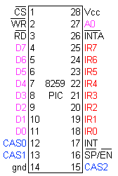
Cascading with other 8259

Slide 38
Cascading with other 8259
CAS2 | CAS1 | CAS0 | PIC
0 | 0 | 0 | PIC1
0 | 0 | 1 | PIC2
0 | 1 | 0 | PIC3
0 | 1 | 1 | PIC4
1 | 0 | 0 | PIC5
1 | 0 | 1 | PIC6
1 | 1 | 0 | PIC7
1 | 1 | 1 | PIC8

Slide 39
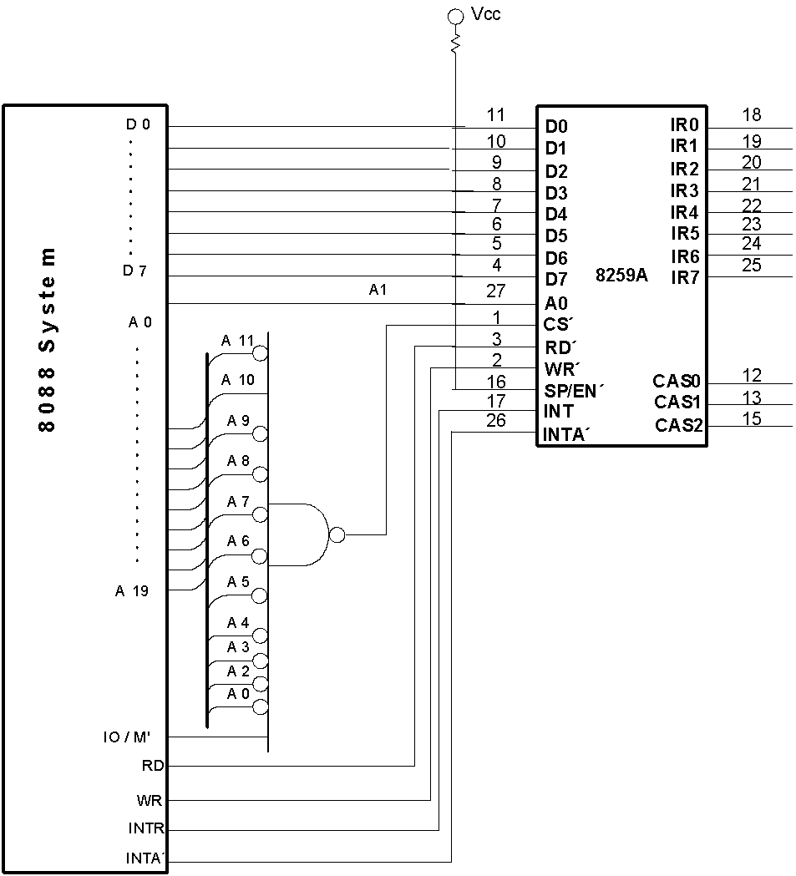
Connecting a single 8259A controller
CSE – 341 : Microprocessors
BRAC University

Slide 40
Thank You !!

Slide 41
The programmable peripheral Interface
The 82C55 programmable peripheral interface (PPI) is a very popular low-cost interfacing component that is used found in many applications.
Applications range from 7-segment display, stepper motor connection, counters to key pad management.
This device is still in use today in P4 Computers and is used to interface and detect key presses on modern keyboards, parallel printers and other interfacing chipsets.
For those of you who are doing computer interfacing course you will be extensively using this device to interface various devices with the PC.

Slide 42
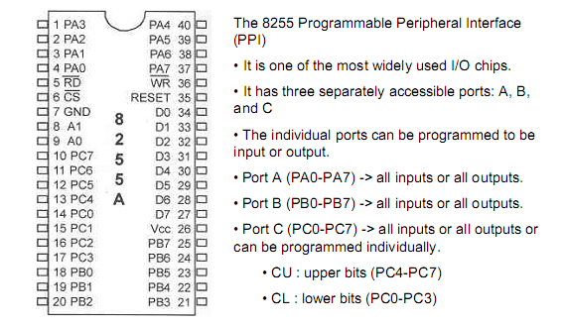
82C55 Programmable Peripheral Interface

Slide 43
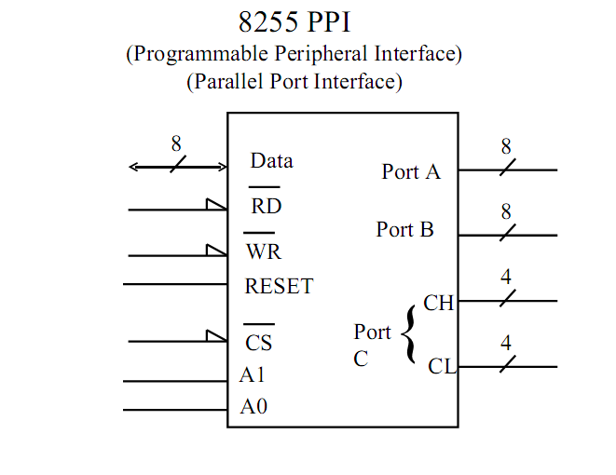

Slide 44
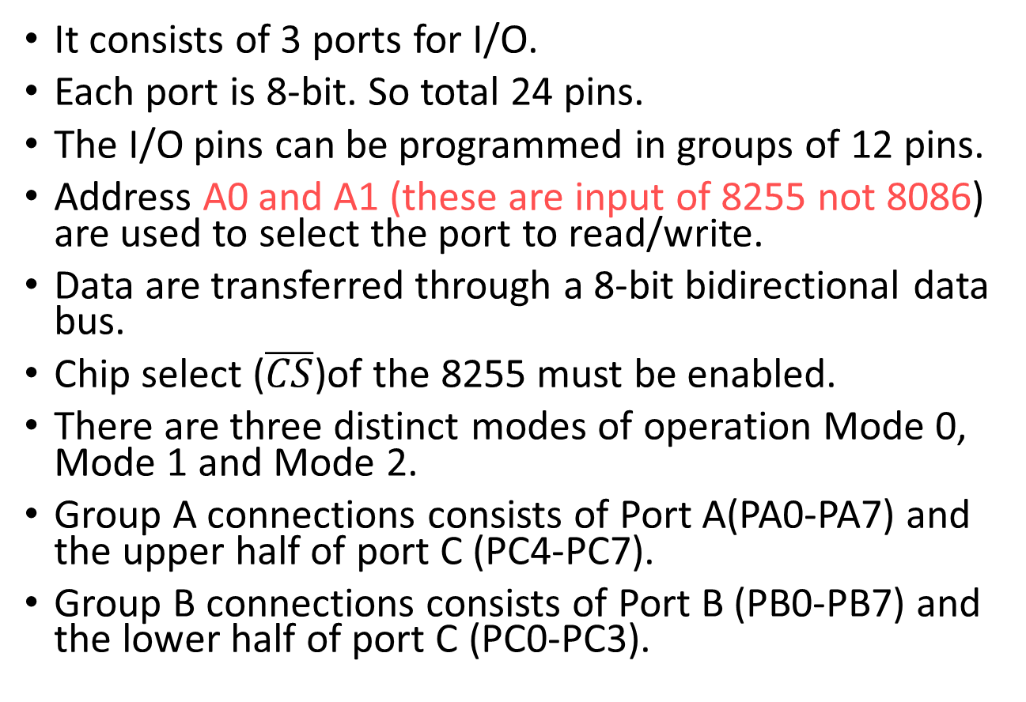
82C55 Features

Slide 45
82C55 port selection table
CS’ | A1 | A0 | SELECTION | ADDRESS
0 | 0 | 0 | PORT A | 80 H
0 | 0 | 1 | PORT B | 81 H
0 | 1 | 0 | PORT C | 82 H
0 | 1 | 1 | Control Register | 83 H
1 | X | X | No Seletion | X
CS pin is used to select the device for reading or writing.
A0 and A1 select the specific port with 82C55

Slide 46
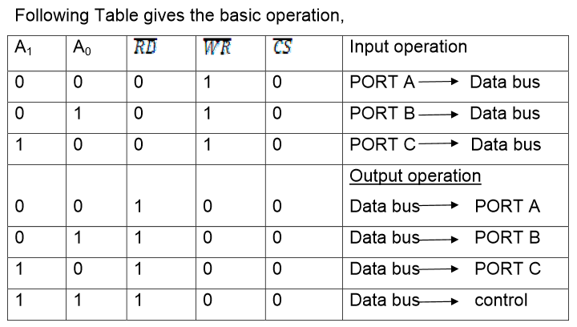

Slide 47
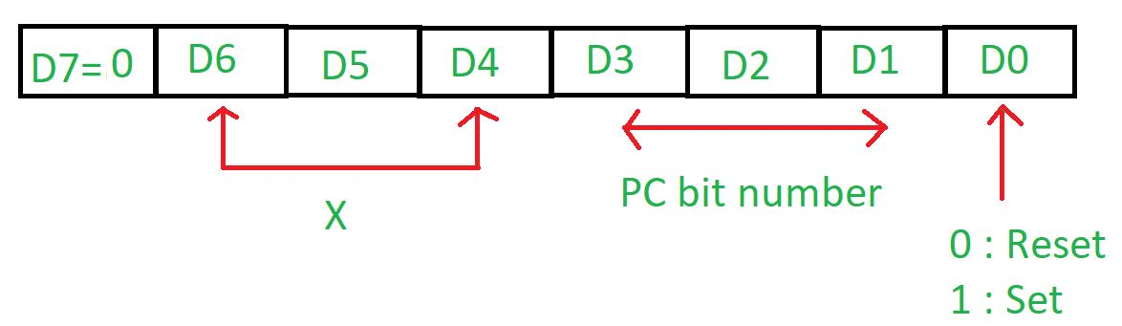
82C55 operation modes
There are 2 modes in 8255 microprocessor:
Bit set reset (BSR) mode – This mode is used to set or reset the bits of port C only, and selected when the most significant bit (D7) in the control register is 0. Control Register is as follows:

Slide 48
82C55 operation modes(Contd.)
Input/output mode (I/O) – This mode is selected when the most significant bit (D7) in the control register is 1.
Mode 0 – Simple or basic I/O mode
Mode 1 – Handshake or strobbed I/O
Mode 2 – Bidirectional I/O

Slide 49
82C55 operation modes(Contd.)
Mode 0 –In this mode all the three ports (port A, B, C) can work as simple input function or simple output function.
Mode 1 – Handshake I/O mode or strobbed I/O mode. In this mode either port A or port B can work as simple input port or simple output port, and port C bits are used for handshake signals before actual data transmission.
Example: A CPU wants to transfer data to a printer. In this case since speed of processor is very fast as compared to relatively slow printer, so before actual data transfer it will send handshake signals to the printer for synchronization of the speed of the CPU and the peripherals.
Mode 2: Bi-directional data bus mode. In this mode only port A works, and port B can work either in mode 0 or mode 1. 6 bits port C are used as handshake signals. It also has interrupt handling capacity.

Slide 50
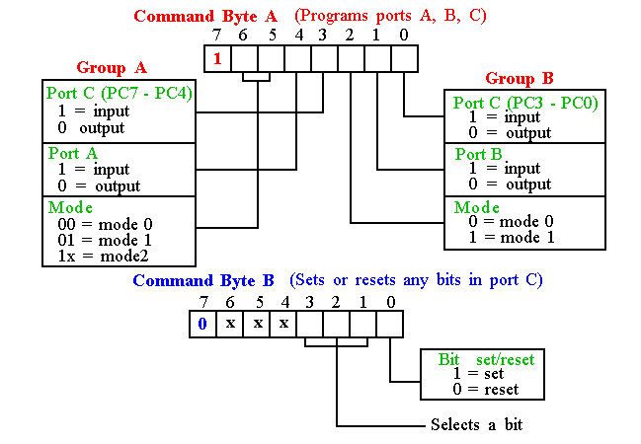
Programming 8255
8255 has three operation modes: mode 0, mode 1, and mode 2

Slide 51
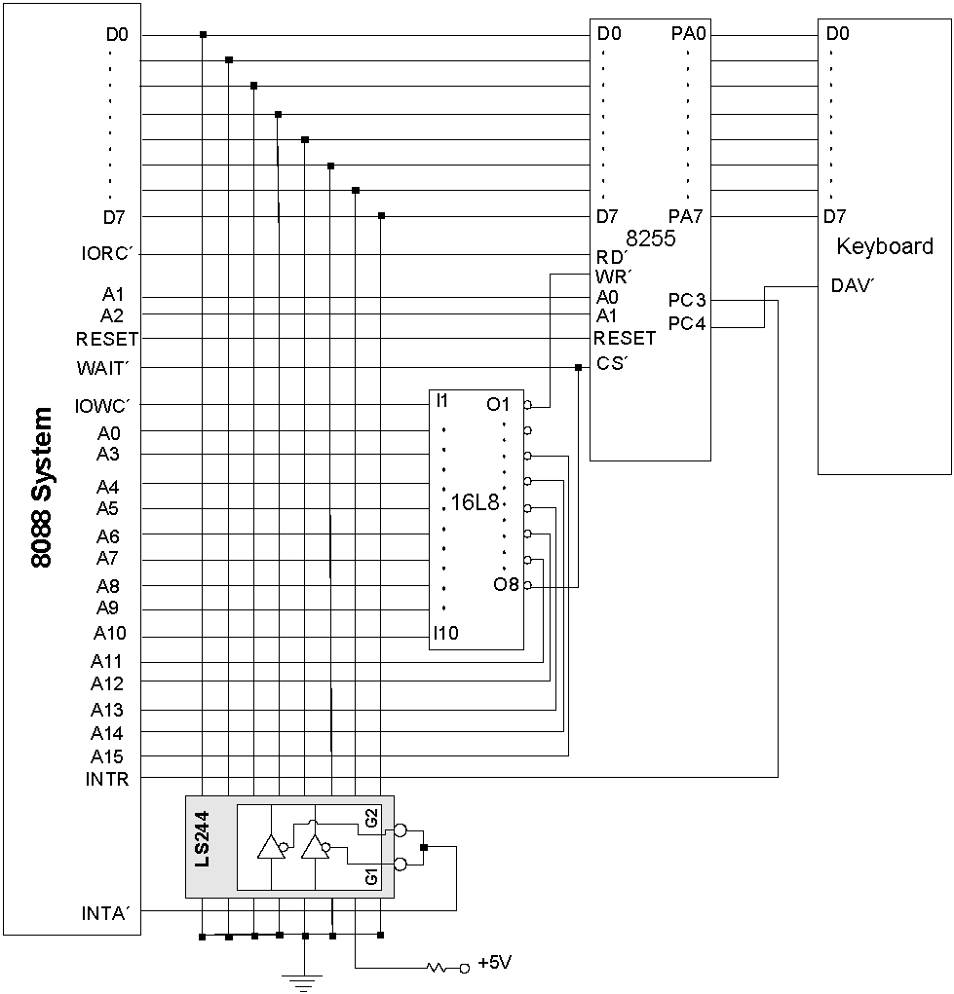
Example - 82C55 Keyboard Interrupt Circuit
CSE – 341 : Microprocessors
BRAC University

